Slide 1
Lab Azure #1
Real-time scoring of Python Scikit-Learn and Deep Learning Models on Azure
Ref: https://github.com/Azure/MLAKSDeployment

Slide 2
Deploying Python Models on a Kubernetes Clusters for Real-Time Scoring
This reference architecture shows how to deploy Python models as web services to make real-time predictions. Two scenarios are covered: deploying regular Python models, and the specific requirements of deploying deep learning models. Both scenarios use the architecture shown.
Two reference implementations for this architecture are available on GitHub, one for regular Python models and one for deep learning models.

Slide 3
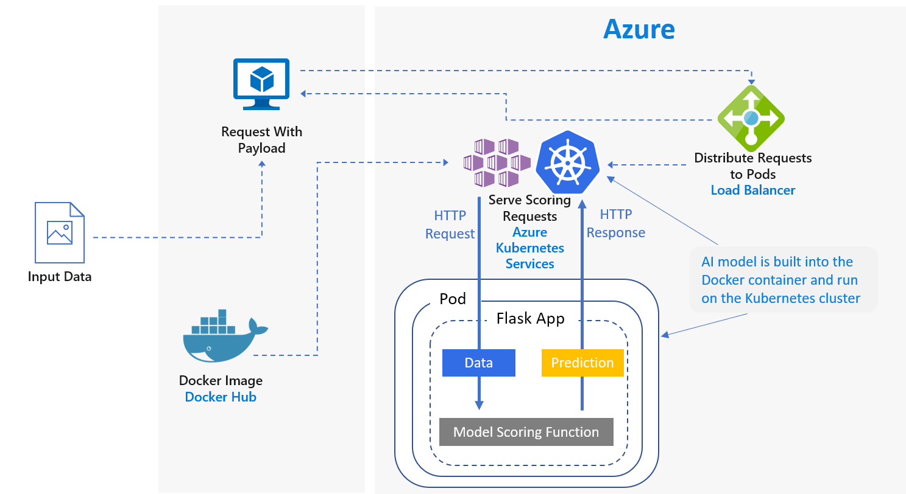
Deploying Python Models on a Kubernetes Clusters for Real-Time Scoring
The scenario uses a subset of Stack Overflow question data which includes original questions tagged as JavaScript, their duplicate questions, and their answers. It trains a Scikit-Learn pipeline to predict the match probability of a duplicate question with each of the original questions. These predictions are made in real time using a REST API endpoint. The application flow for this architecture is as follows:

Slide 4
Deploying Python Models on a Kubernetes Clusters for Real-Time Scoring
The client sends a HTTP POST request with the encoded question data.
The Flask app extracts the question from the request
The question is then sent to the Scikit-learn pipeline model for featurization and scoring.
The matching FAQ questions with their scores are then piped into a JSON object and returned to the client.
An example app that consumes the results is included with the scenario.

Slide 5
Deploying Python Models on a Kubernetes Clusters for Real-Time Scoring
Linux(Ubuntu).
Anaconda Python
Docker installed.
DockerHub account.
Azure account.
The tutorial was developed on an Azure Ubuntu DSVM, which addresses the first three prerequisites.
Follow steps: how to provision ubuntu data science VM
https://docs.microsoft.com/en-us/azure/machine-learning/data-science-virtual-machine/dsvm-ubuntu-intro

Slide 6
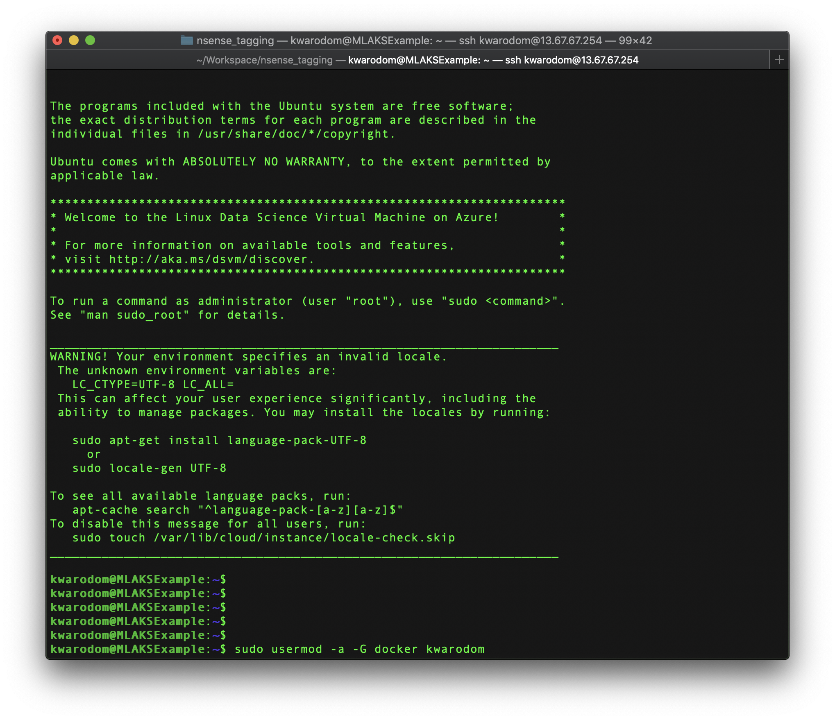
Deploying Python Models on a Kubernetes Clusters for Real-Time Scoring
Setup
To set up your environment to run these notebooks, please follow these steps. They setup the notebooks to use Docker and Azure seamlessly.
Create a Linux DSVM. https://docs.microsoft.com/en-us/azure/machine-learning/data-science-virtual-machine/dsvm-ubuntu-intro - you can go to your vm using <public ip address>:8000
In a bash shell on the DSVM, add your login to the docker group:
$ sudo usermod -a -G docker <login>

Slide 7
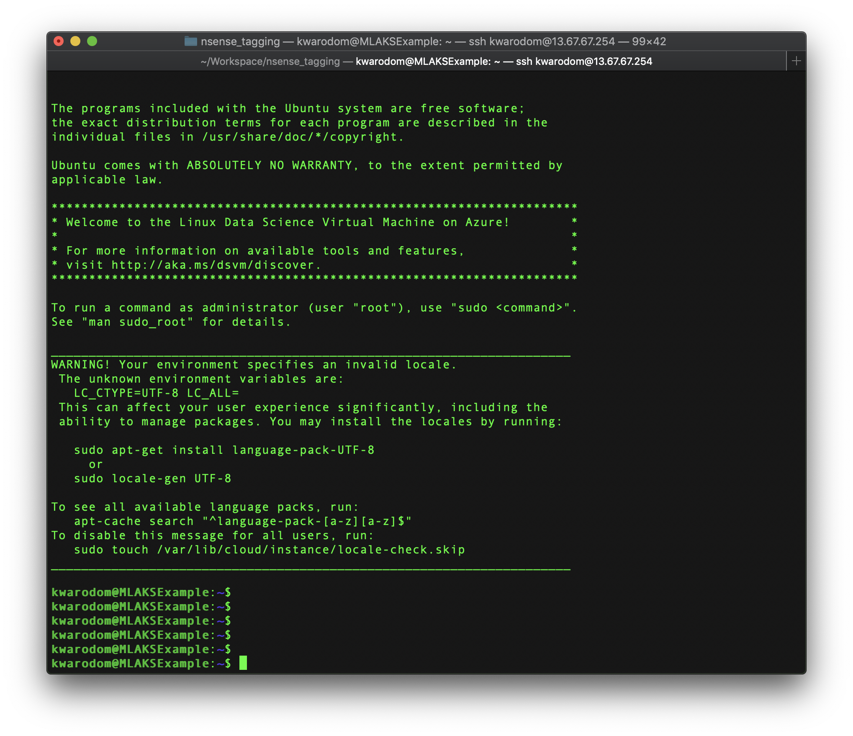
Deploying Python Models on a Kubernetes Clusters for Real-Time Scoring

Slide 8
Deploying Python Models on a Kubernetes Clusters for Real-Time Scoring
4. Clone, fork, or download the zip file for this repository:
$ git clone https://github.com/Azure/MLAKSDeployment.git

Slide 9
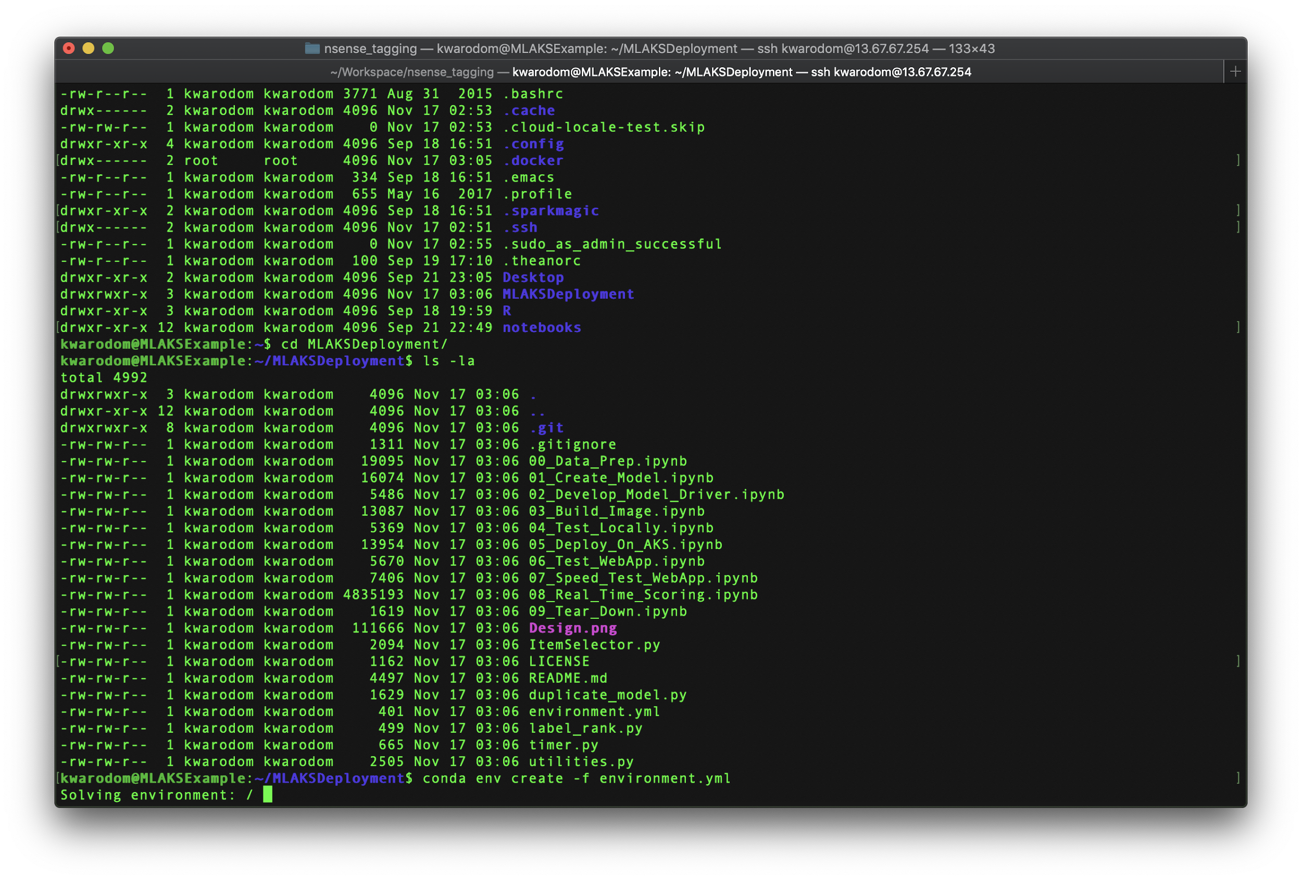
Deploying Python Models on a Kubernetes Clusters for Real-Time Scoring
5. Create the Python MLAKSDeployment virtual environment using the environment.yml:

Slide 10
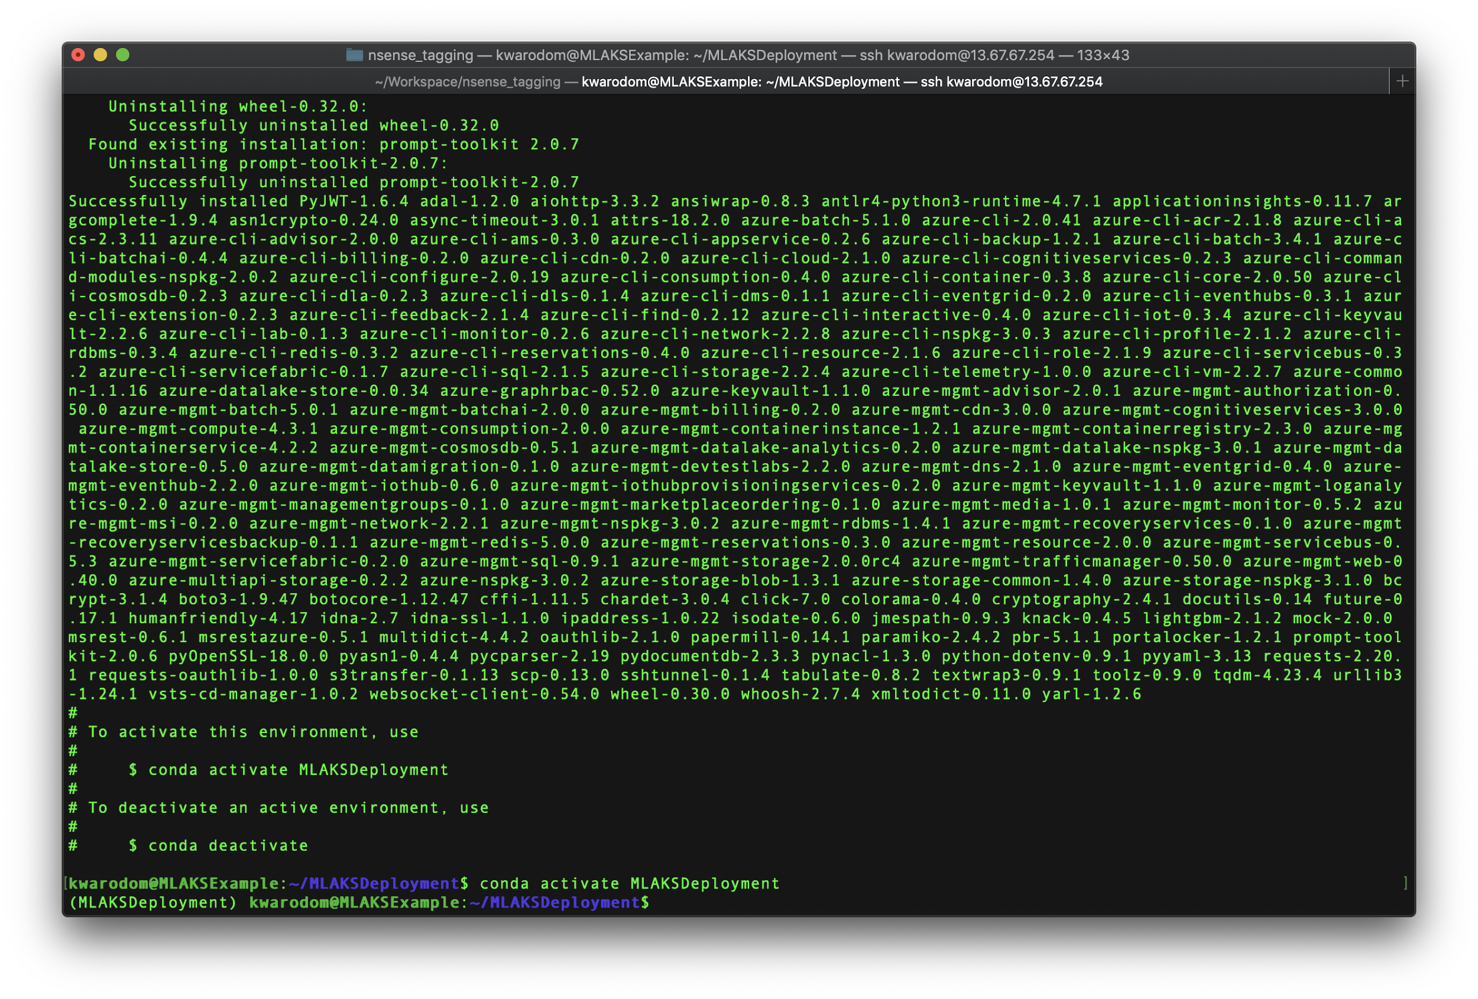
Deploying Python Models on a Kubernetes Clusters for Real-Time Scoring
6. Activate the virtual environment
$ source activate MLAKSDeployment

Slide 11
Deploying Python Models on a Kubernetes Clusters for Real-Time Scoring
7. Login to Azure
$ sudo az login
$ sudo az account-set --subscription <Your Azure Subscription>

Slide 12
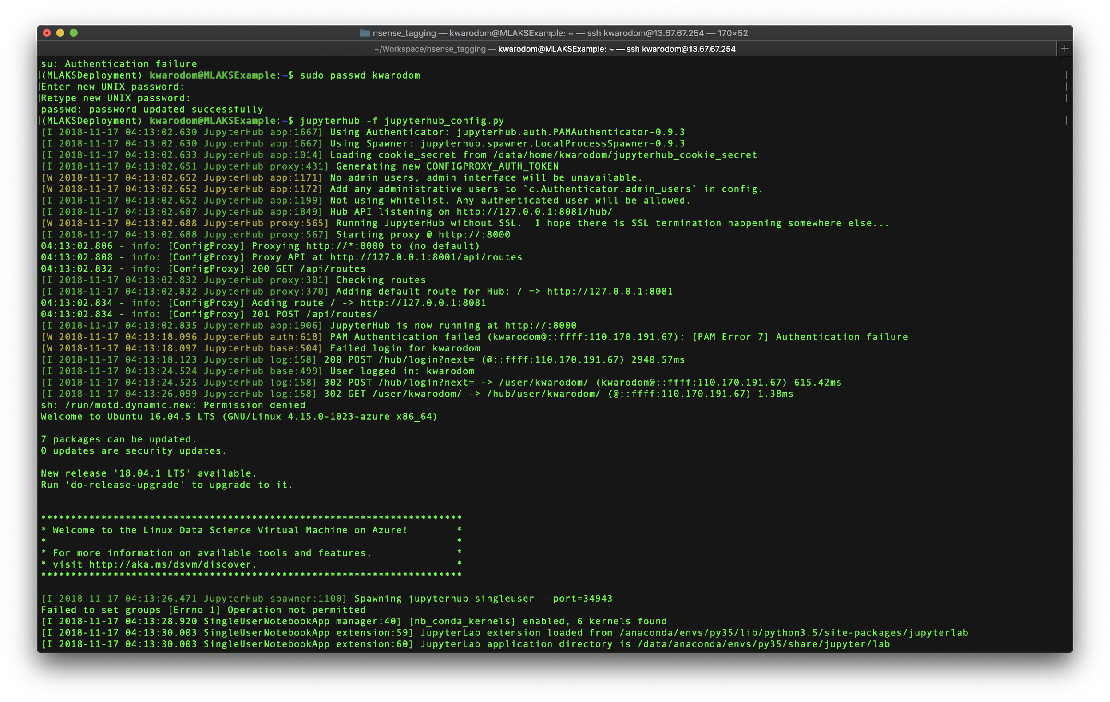
Deploying Python Models on a Kubernetes Clusters for Real-Time Scoring
8. Install Jupyterhub
To install JupyterHub along with its dependencies including nodejs/npm:
conda install -c conda-forge jupyterhub==0.9.3
If you plan to run notebook servers locally, install the Jupyter notebook or JupyterLab:
conda install notebook
conda install jupyterlab

Slide 13
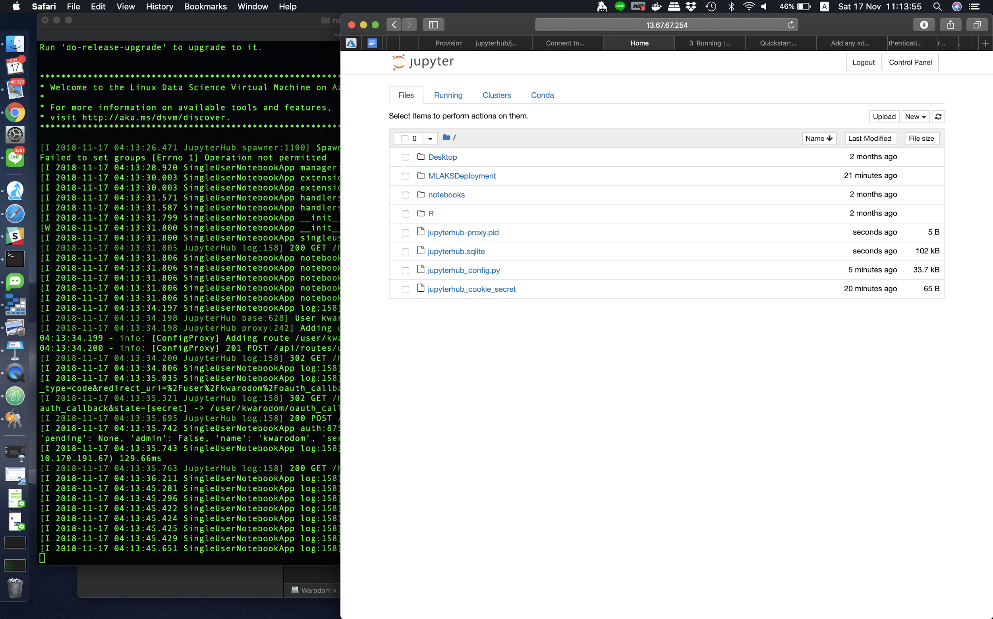
Deploying Python Models on a Kubernetes Clusters for Real-Time Scoring
9. Run the Hub server
Create a configuration file
$ jupyterhub --generate-config
If you plan to run notebook servers locally, install the Jupyter notebook or JupyterLab
$conda update all
$ jupyterhub -f jupyterhub_config.py
Getting started with JupyterHub tutorial
https://github.com/jupyterhub/jupyterhub-tutorial

Slide 14
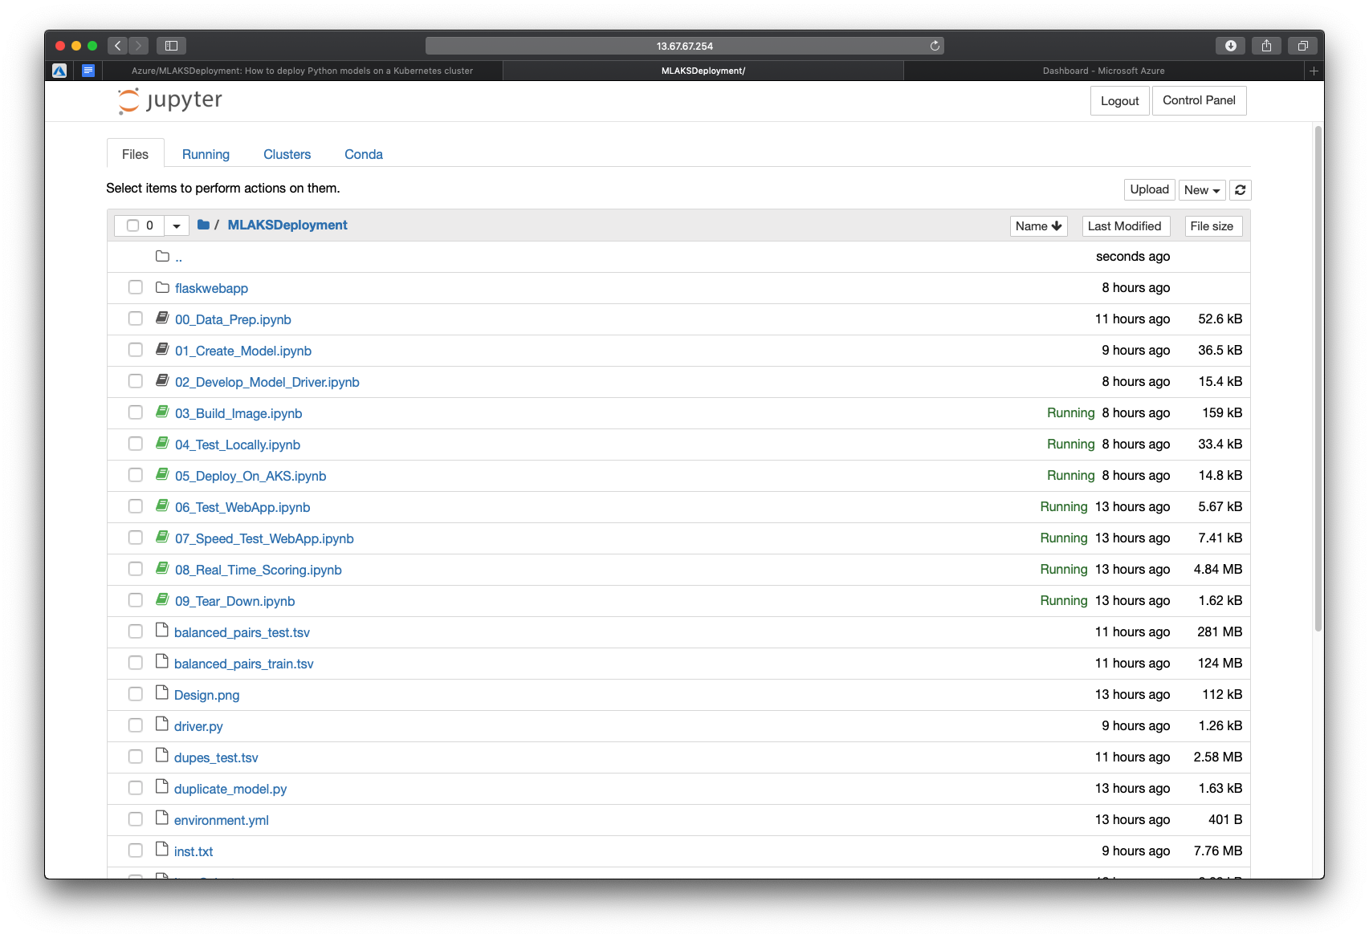
Deploying Python Models on a Kubernetes Clusters for Real-Time Scoring
10. Let’s start from MLAKSDeployment

Slide 15
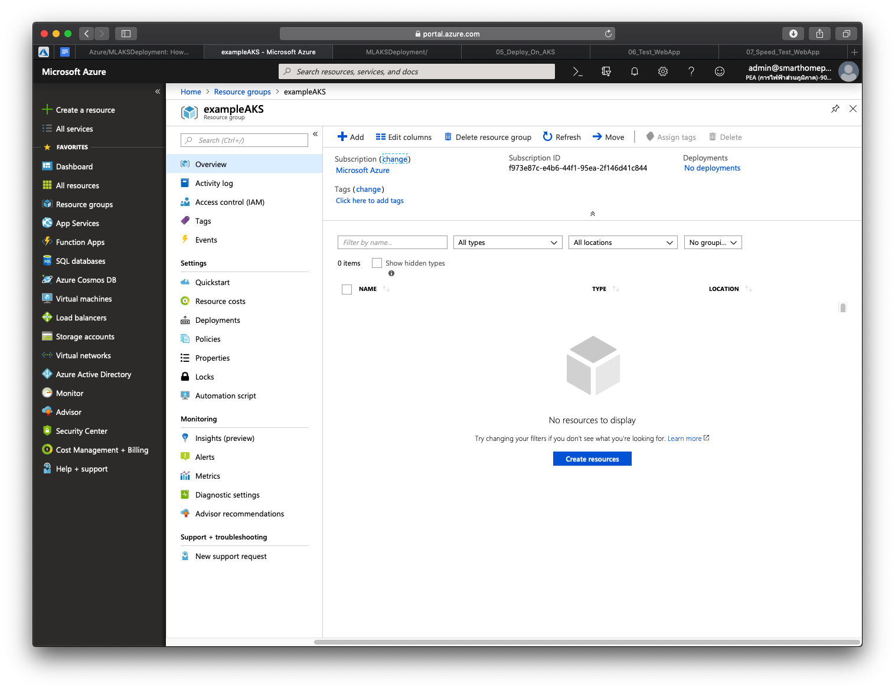
Deploying Python Models on a Kubernetes Clusters for Real-Time Scoring
Deployment on AKS
After creating new resource group

Slide 16
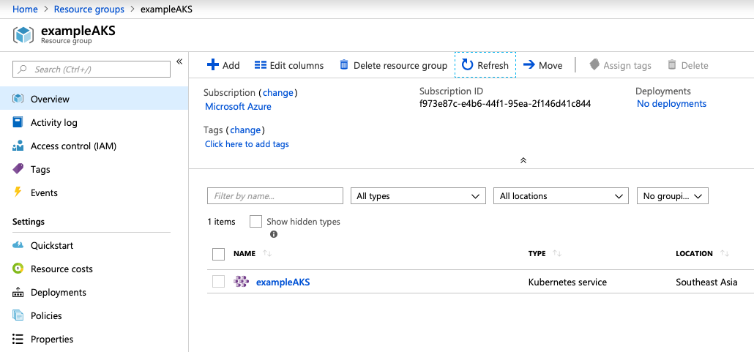
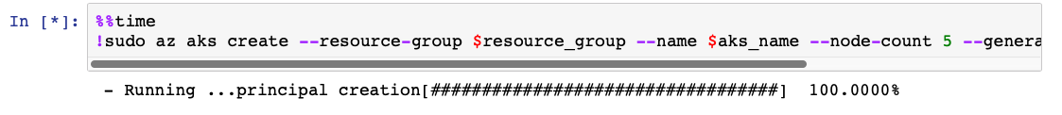
Deploying Python Models on a Kubernetes Clusters for Real-Time Scoring
Deployment on AKS
Below, we create the AKS cluster with 5 nodes in the resource group we created earlier. This step can take ten or more minutes.

Slide 17
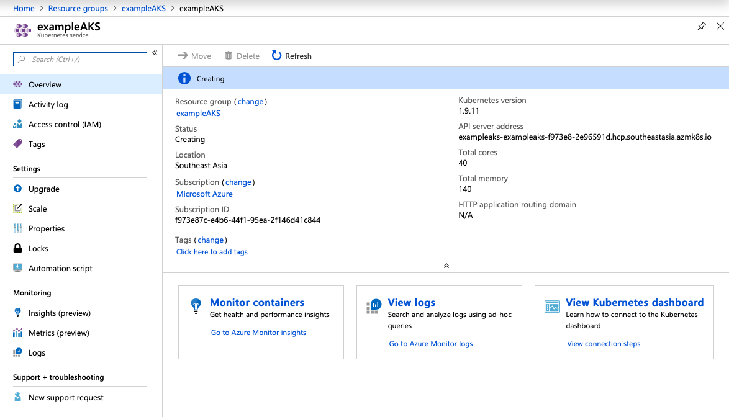
Deploying Python Models on a Kubernetes Clusters for Real-Time Scoring
Deployment on AKS

Slide 18
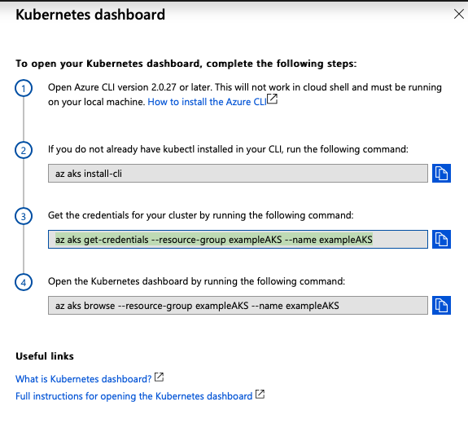
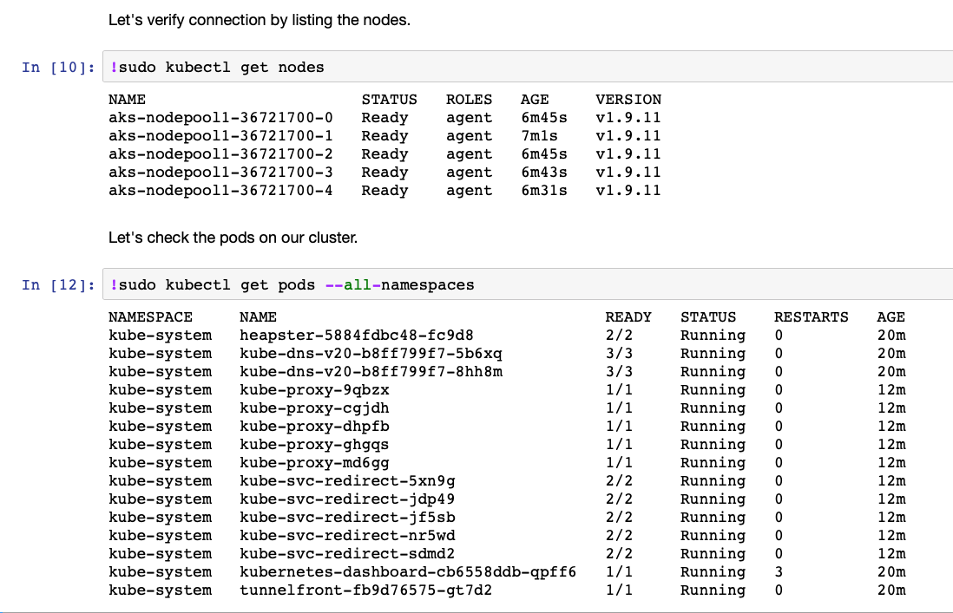
Deploying Python Models on a Kubernetes Clusters for Real-Time Scoring
Deployment on AKS

Slide 19
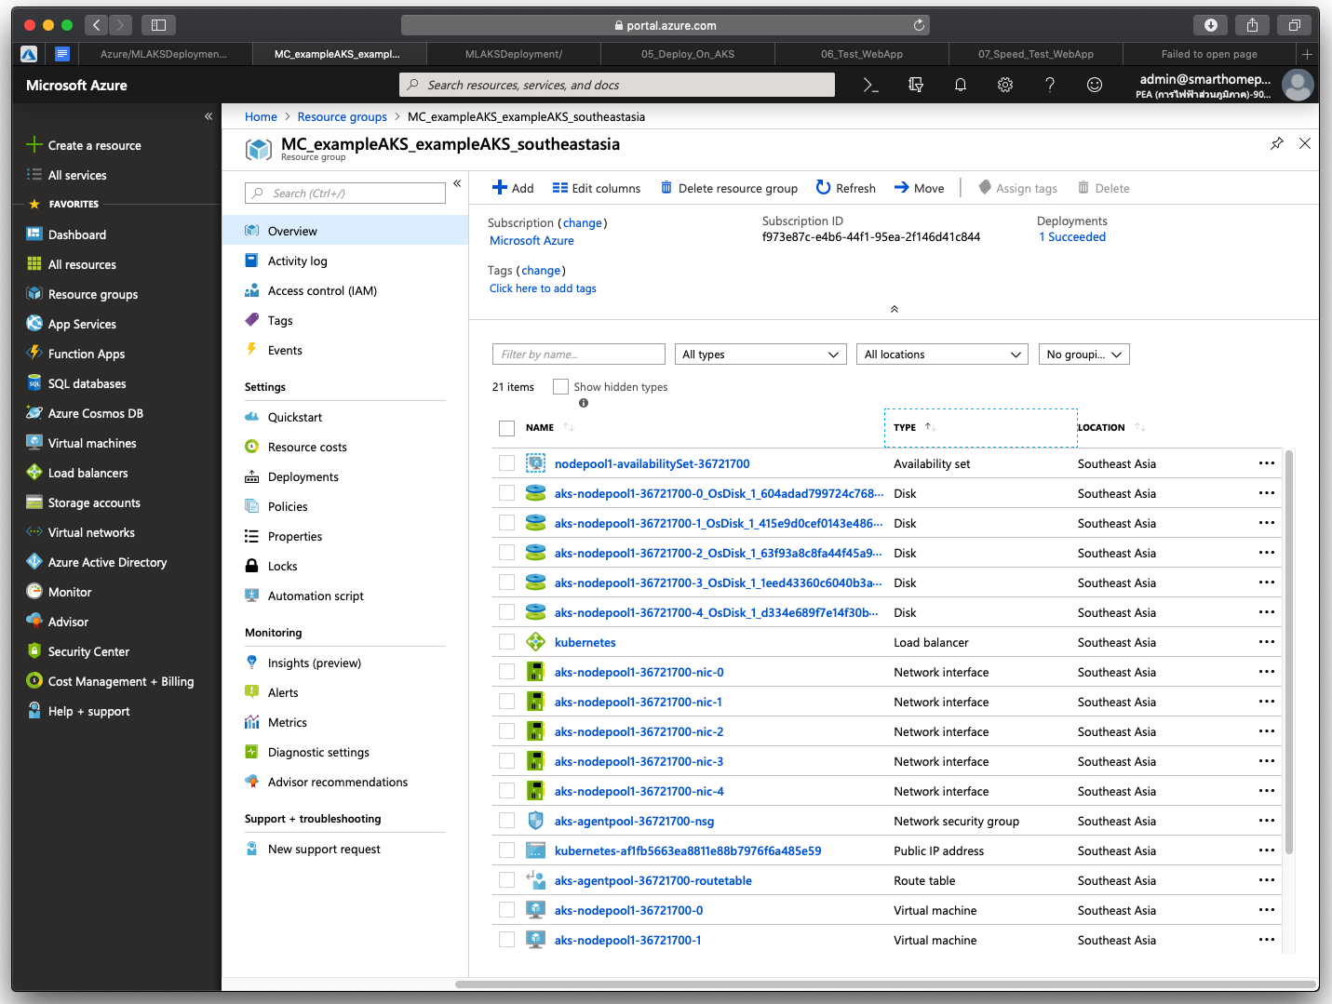
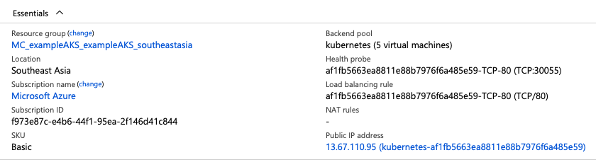
Deploying Python Models on a Kubernetes Clusters for Real-Time Scoring
Deployment on AKS

Slide 20
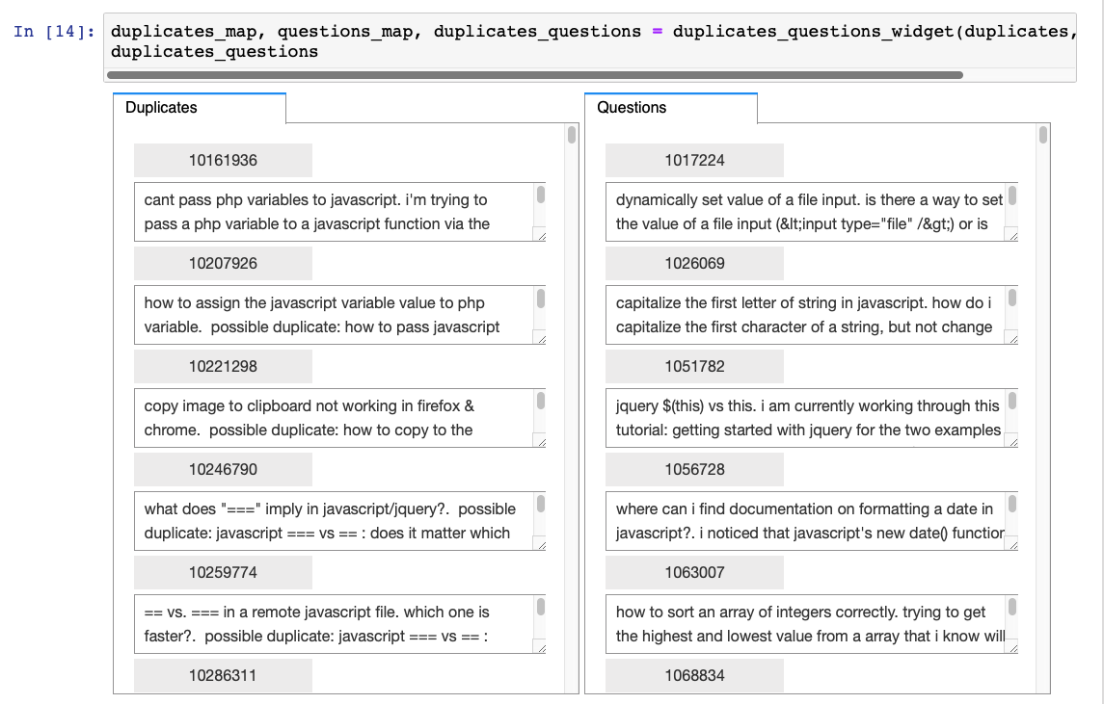
Deploying Python Models on a Kubernetes Clusters for Real-Time Scoring
Step8. Real Time Scoring

Slide 21
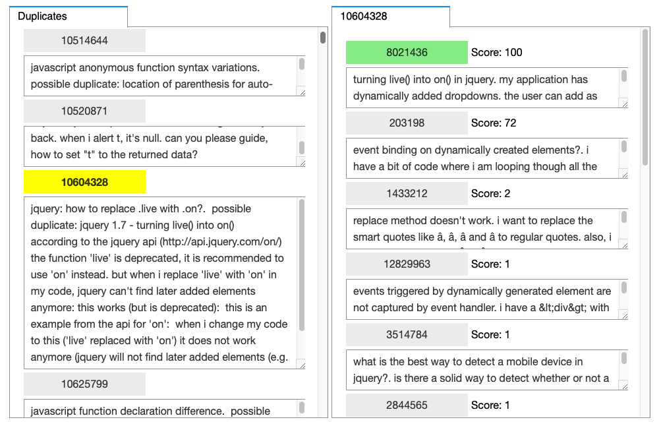
Deploying Python Models on a Kubernetes Clusters for Real-Time Scoring
Step8. Real Time Scoring

Slide 22
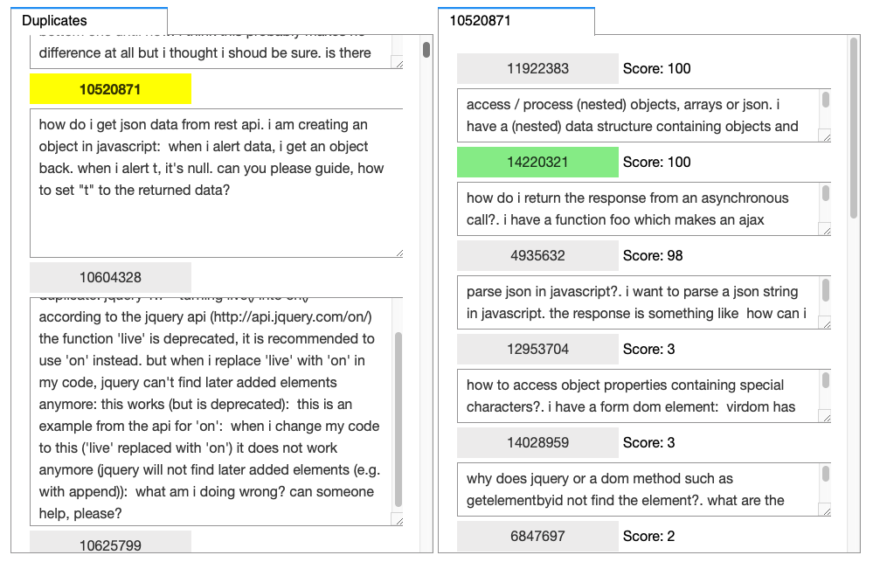
Deploying Python Models on a Kubernetes Clusters for Real-Time Scoring
Step8. Real Time Scoring

